Slide 1
L3 Tensor Operations and Gradients

Slide 2
Calculating Derivatives
Derivatives are one of the most fundamental concepts in calculus.
They describe how changes in the variable inputs affect the function outputs

Slide 3

Approaches for Computing Derivatives
1. Symbolic differentiation: automatic manipulation of mathematical expressions to get derivatives
Takes a math expression and returns a math expression:
Used in Mathematica, Maple, Sympy, etc.
2. Numeric differentiation: Approximating derivatives by finite differences
3. Automatic differentiation: Takes code that computes a function and returns code that computes the derivative of that function.
autograd is a Python package for automatic differentiation
autograd does not support GPUs, so we cannot use autograd for training big neural networks.
Pytorch is a gpu friendly framework on top of autograd.
PyTorch allows to dynamically define computational graphs that can be computed efficiently on GPUs

Slide 4
Approaches for Computing Derivatives
autograd is a Python package for automatic differentiation
autograd does not support GPUs, so we cannot use autograd for training big neural networks.
Pytorch is a GPU friendly framework on top of autograd.
PyTorch allows to dynamically define computational graphs that can be computed efficiently on GPUs. PyTorch rebuilds the graph every time we iterate or change it and hence uses a dynamic graph
PyTorch generates derivatives by building a backwards graph behind the scenes

Slide 5
Methods and attributes for computing derivatives in PyTorch
requires_grad : to automatically compute the derivative of y w.r.t. the tensors that have requires_grad set to True
requires_grad=True : ensures that any expression involving tensors with that attribute are differentiable with respect to these tensors
.backward(): Perform a backward pass to compute gradients
.grad: access the gradient - to track operations for gradient computation. The "grad" stands for gradient, which is another term for derivative
gradients can only be calculated for floating point tensors so create a float type array before making it a gradient enabled PyTorch tensor
In default case, the backward() is applied to scalar-valued function
Gradients are calculated by tracing the graph from the root to the leaf and multiplying every gradient in the way using the chain rule.

Slide 6
Methods and attributes for computing derivatives in PyTorch
Multiple ways to initialize
Define the requires_grad in the constructor
t1 = torch.randn((3,3), requires_grad = True)
some require to set manually after creation of the Tensor
t2 = torch.FloatTensor(3,3) # No way to specify requires_grad while initiating
t2.requires_grad = True

Slide 7
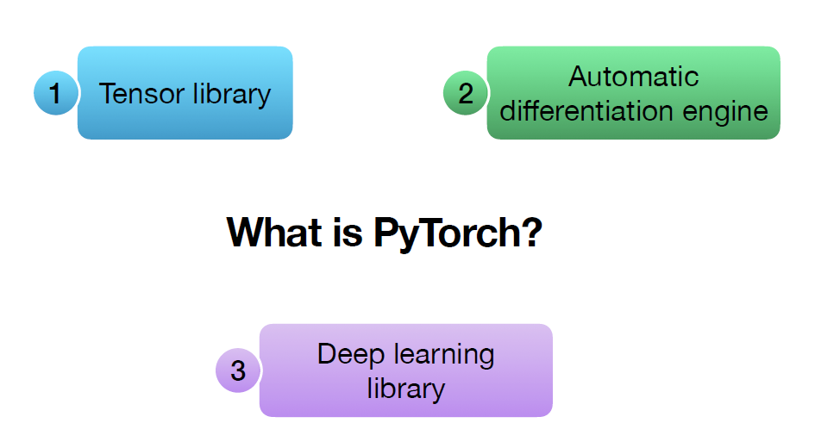
PyTorch Library

Slide 8
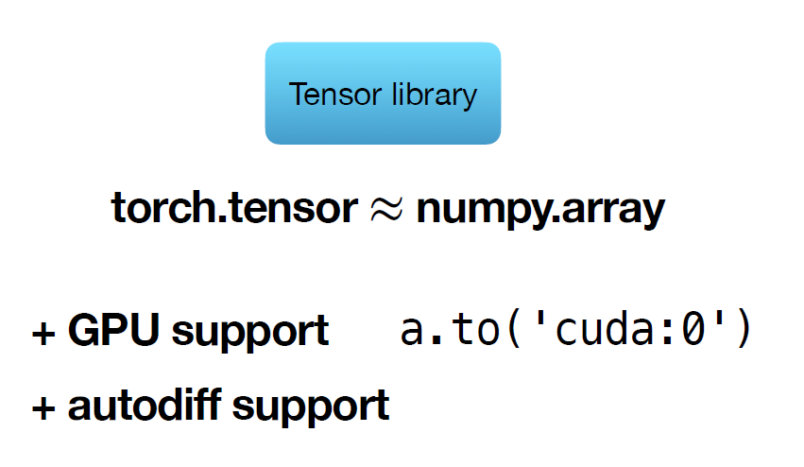
PyTorch Library

Slide 9


Computing derivative – Problem 1
Calculate the derivative dy/dx and write Python code for the same
​

Slide 10
Computing derivative – Problem 1
import torch
# Create a variable with requires_grad=True
x = torch.tensor([2.0], requires_grad=True)
# Define the function
y = 3 * x**2 + 2 * x + 1
# Perform a backward pass to compute gradients
y.backward() # differentiation of y
# Access the gradient
gradient = x.grad #find the derivative dy/dx
# .item() - Gets the Python number within a tensor - only #works with one-element tensors
print("Input variable (x):", x.item())
print("Result of the expression (y):", y.item())
print("Gradient of y with respect to x:", gradient.item())
Calculate the derivative dy/dx and write Python code
The derivates of y w.r.t the input tensor, x is stored in the .grad property of x : x.grad
​
Input variable (x): 2.0
Result of the expression (y): 17.0
Gradient of y with respect to x: 14.0

Slide 11
Computational Graph in PyTorch
PyTorch defines a computational graph as a Directed Acyclic Graph (DAG) where
nodes represent operations (e.g., addition, multiplication, etc.) and
edges represent the flow of data between the operations.
In the context of deep learning (and PyTorch) it is helpful to think about neural networks as computation graphs
When defining a PyTorch model, the computational graph is created by defining the forward function of the model.
This function takes inputs and applies a sequence of operations to produce the outputs.
During the forward pass, PyTorch creates the computational graph by keeping track of the operations and their inputs and outputs.
In the backpropagation step, the graph is used to compute gradients and monitor the dependencies between computations.

Slide 12
Computational Graph in PyTorch
A computational graph is a graphical representation of a mathematical function or algorithm, where the
nodes of the graph represent mathematical operations, and the
edges represent the input/output relationships between the operations.
Computational graphs are widely used in deep learning
In a neural network, each
node in the computational graph represents a neuron, and the
edges represent the connections between neurons.

Slide 13
Computing derivative – Problem 2
Solve for y=wx+b, at x=3, w=4, b=5 and compute ∂y/∂w and ∂y/ ∂b

Slide 14
Computing derivative – Problem 2
Create 3 tensors x, w and b, with values 3, 4 and 5
w and b to have an additional parameter requires_grad set to True.
Create a new tensor y : y=wx+b
y is a tensor with the value 3 * 4 + 5 = 17.
To compute the derivatives, call the .backward method on result y.
The derivates of y w.r.t the input tensors, x, w and b are stored in the .grad property of the respective tensors, x, w and b: x.grad, w.grad, b.grad

Slide 15
Computing derivative – Problem 2
# Create tensors
import torch
x = torch.tensor(3.)
w = torch.tensor(4., requires_grad=True)
b = torch.tensor(5., requires_grad=True)
print(x, w, b)
# Arithmetic operations
y = w * x + b
print(y)
# Compute derivatives
y.backward()
# Display gradients
print('dy/dx:', x.grad)
print('dy/dw:', w.grad)
print('dy/db:', b.grad)
tensor(3.) tensor(4., requires_grad=True) tensor(5., requires_grad=True)
tensor(17., grad_fn=<AddBackward0>)
dy/dx: None
dy/dw: tensor(3.)
dy/db: tensor(1.)
dy/dw has the same value as x i.e. 3,
dy/db has the value 1.
x.grad is None, because x does not have requires_grad set to True
Note: grad_fn=<AddBackward0> means the last operation on the output was Add operation.

Slide 16
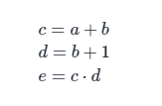
Computational Graphs – Problem 3
Computational Graphs represent symbolic expressions
In the context of the Single layer Perceptron (SLP), the given equations for the forward- and backward-pass are symbolic expressions.
In general, any expression of this type can be represented by a graph.
Ex1: e=(a+b)*(b+1)
Breaking down to atomic operations yields:
Note: computational graphs are very closely related to dependency graphs and call graphs

Slide 17
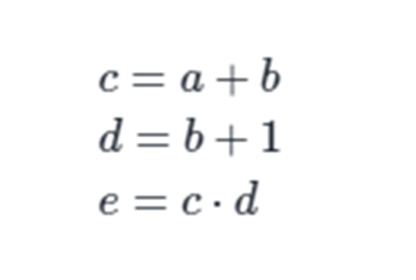
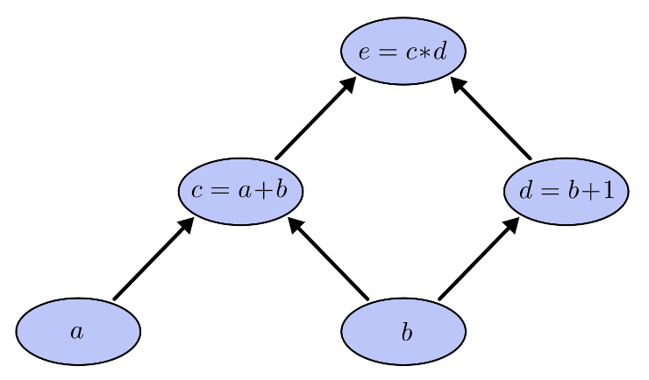
Computational Graphs – Problem 3
Nodes in the compute graph represent either input variables or basic operations (or functions)
Edges indicate variables applied as operands in operation (arguments are applied for function)

Slide 18
Computational Graphs -Evaluating Expressions- – Problem 3
By assigning values to the input variables the graph is evaluated and
Values are produced at the output nodes.
Ex: assigning the values a=2, b=1
Other variables in the graph are evaluated and the result of this evaluation is 6

Slide 19
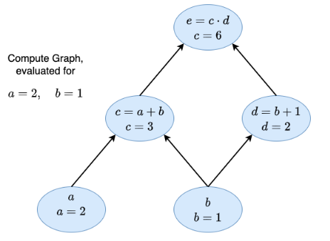
Computational Graphs -Evaluating Expressions- – Problem 3

Slide 20
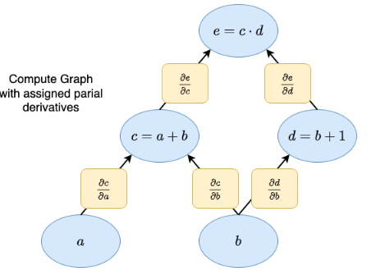
Partial derivatives in Computational Graphs – Problem 3

Slide 21
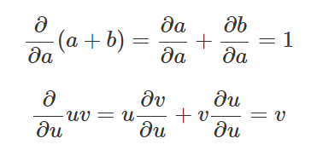
Evaluating the partial derivatives - – Problem 3
To evaluate the partial derivatives in this graph, need the sum rule and the product rule:

Slide 22
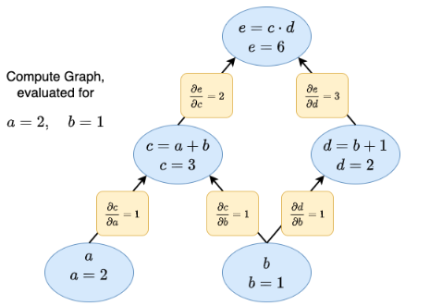
Partial derivatives in Computational Graphs - Problem 3
The values for the partial derivatives for the assignment a=2, b=1
Partial derivative on each edge labeled

Slide 23

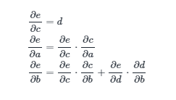
Partial derivatives in Computational Graphs - Problem 3
With this representation we can easily calculate any partial derivation
Very Important
For calculating the partial derivatives, we just apply the well known chain rule.
However, if we have visualized our expression in a computational graphs, we can easily determine which partial-derivative-factors must be multiplied and for which paths the products must be added

Slide 24

Partial derivatives in Computational Graphs - Problem 3
The general rule is to sum over all possible paths from one node to the other, multiplying the derivatives on each edge of the path together.
Ex: to get the derivative of e with respect to b
This accounts for how b affects e through c and also how b affects e through d.
This general “sum over paths” rule is the multivariate chain rule
Back propagation is same as chain rule

Slide 25
Partial derivatives in Computational Graphs - Problem 3- Complete the program
a = torch.tensor(2.0, requires_grad=True) # we set requires_grad=True to let PyTorch know to keep the graph
b = torch.tensor(1.0, requires_grad=True)
c = a + b
d = b + 1
e = c * d
print('c', c)
print('d', d)
print('e', e)
c tensor(3., grad_fn=<AddBackward0>)
d tensor(2., grad_fn=<AddBackward0>)
e tensor(6., grad_fn=<MulBackward0>)

Slide 26
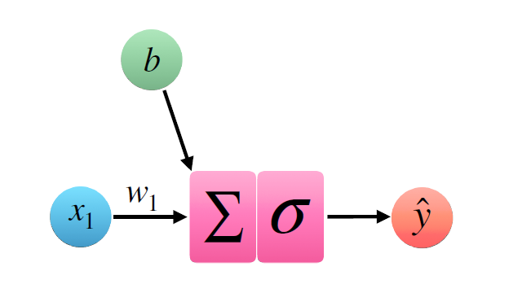
Computation graphs – Problem 4

Slide 27
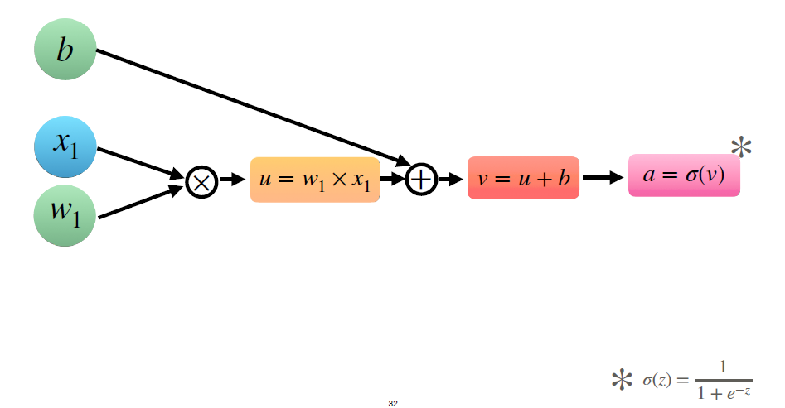
Computation graphs – Problem 4

Slide 28
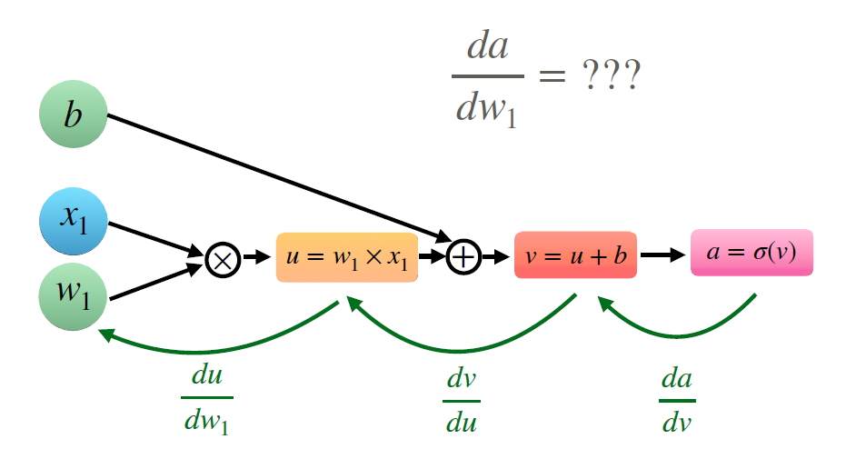
Computation graphs – Problem 4

Slide 29
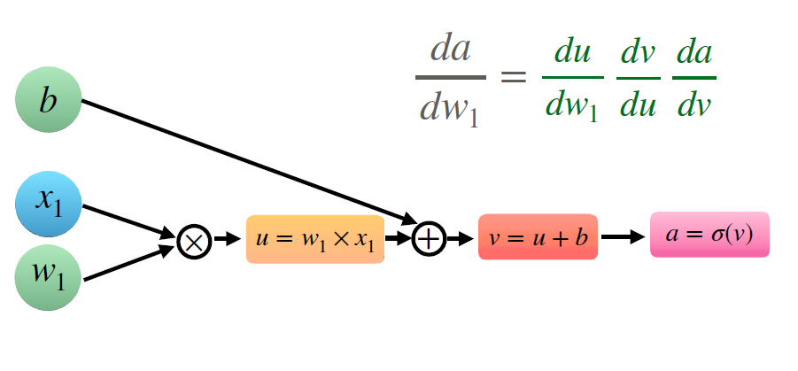
Computation graphs – Problem 4

Slide 30
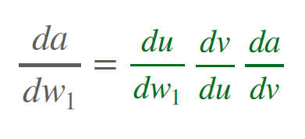
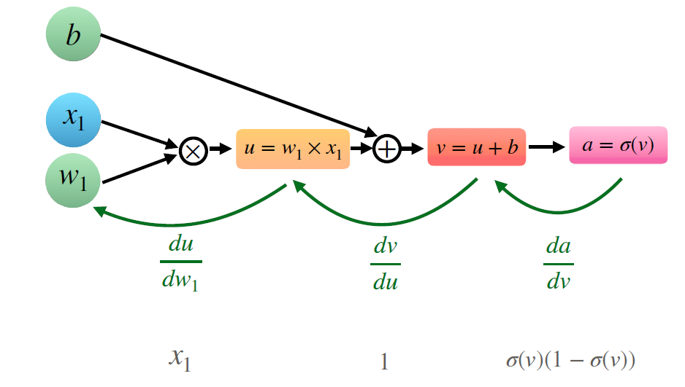
Computation graphs – Problem 4

Slide 31

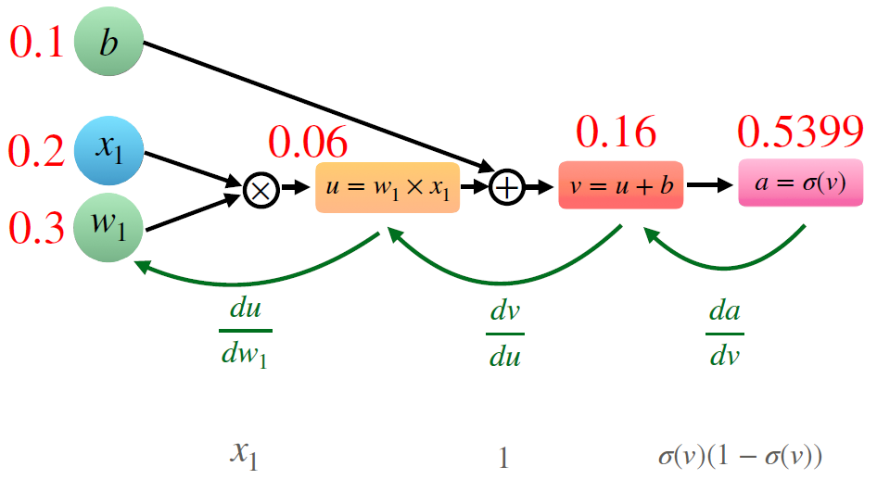
Computation graphs – Problem 4

Slide 32
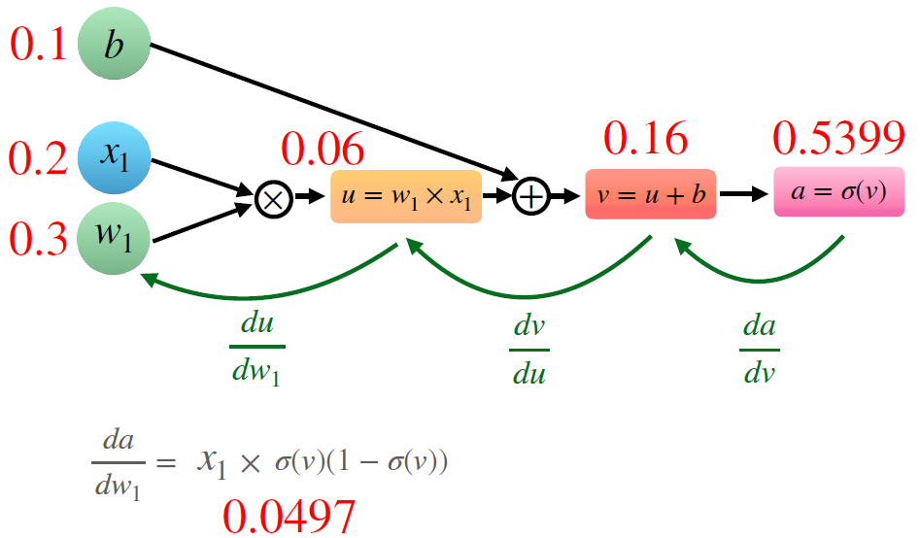
Computation graphs – Problem 4

Slide 33
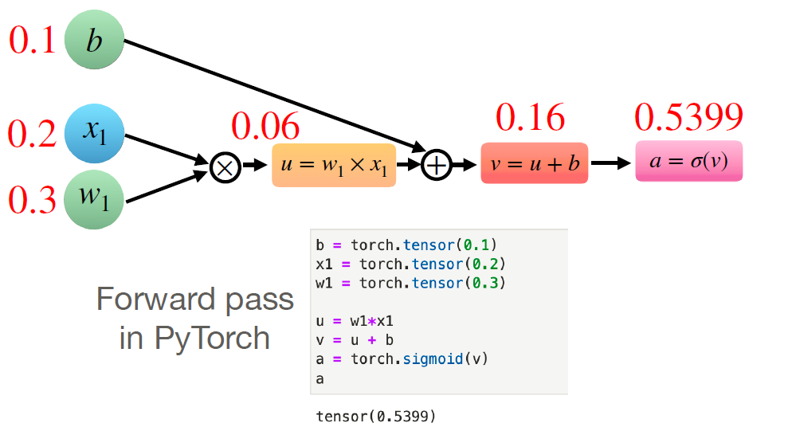
Computation graphs – Problem 4

Slide 34
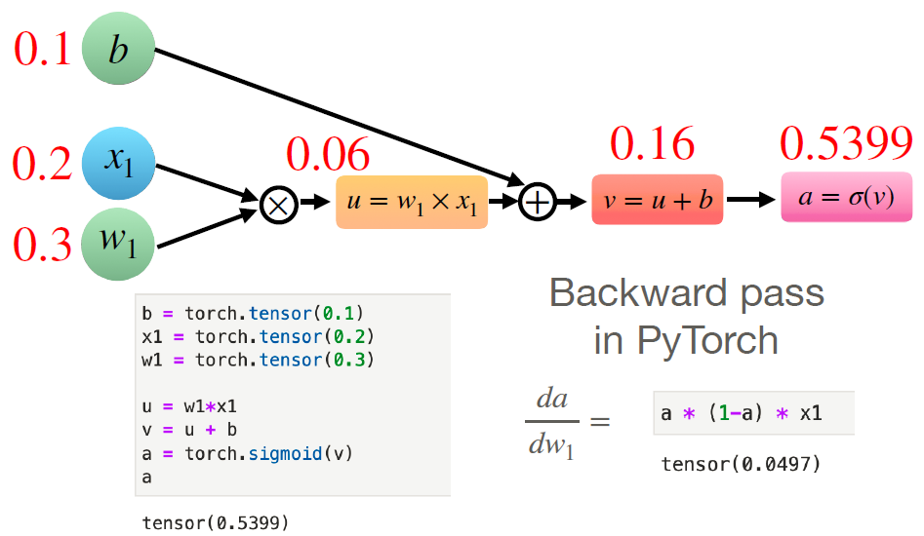
Computation graphs – Problem 4

Slide 35
Computing derivative – Problem 5
z=log(3x2+5xy)- compute dz/dx and dz/dy
x=2, y=3

Slide 36
Computing derivative – Problem 5
z=ln(3x²+5xy) #compute dz/dx and dz/dy
import torch
x = torch.tensor([2.0], requires_grad=True)
y = torch.tensor([3.0], requires_grad=True)
z = torch.log(3*x**2 + 5*x*y)
print("z = ", z)
z.backward()
print("x.grad = ", x.grad)
print("y.grad = ", y.grad)
z = tensor([3.7377],grad_fn=<LogBackward0>)
x.grad = tensor([0.6429])
y.grad = tensor([0.2381])
log here is ln or log e – natural log
d (ln x) /dx = 1/x * d(x)/dx

Slide 37
Computing derivative – Problem 5
For the same problem, use intermediate variables and draw computation graph
z=log(3x²+5xy)
a = x**2
b = 3 * a
c = x * y
d = 5 * c
e = b + d
z = torch.log(e)

Slide 38
Computing derivative – Problem 5– retain_grad()
While we declare x and y with requires_grad=True, x.grad and y.grad computations are available.
x = torch.tensor([2.0], requires_grad=True)
y = torch.tensor([3.0], requires_grad=True)
But a.grad, b.grad, c.grad, d.grad, e.grad are not stored by default.
a.requires_grad=True # RuntimeEror
RuntimeError: you can only change requires_grad flags of leaf variables.
To store all intermediate values in the backward propagation, explicitly encode all intermediate steps to remember (retain) their derivative values by using retain_grad()
a.retain_grad() computes a.grad and the same way, all intermediate variables are to be set.
z.backward() is same as z.backward(retain_graph=False)

Slide 39
Computing derivative – Problem 5
print(z)
print("x grad = ", x.grad)
print("y grad = ", y.grad)
print("a grad = ", a.grad)
print("b grad = ", b.grad)
print("c grad = ", c.grad)
print("d grad = ", d.grad)
print("e grad = ", e.grad)
print("z grad = ", z.grad)
x = torch.tensor([2.0], requires_grad=True)
y = torch.tensor([3.0], requires_grad=True)
a = x**2; a.retain_grad()
b = 3 * a; b.retain_grad()
c = x * y; c.retain_grad()
d = 5 * c; d.retain_grad()
e = b + d; e.retain_grad()
z = torch.log(e); z.retain_grad() #dz/dz=1
z.backward(retain_graph=False) #same as z.backward()
tensor([3.7377], grad_fn=<LogBackward0>)
x grad = tensor([0.6429])
y grad = tensor([0.2381])
a grad = tensor([0.0714])
b grad = tensor([0.0238])
c grad = tensor([0.1190])
d grad = tensor([0.0238])
e grad = tensor([0.0238])
z grad = tensor([1.])

Slide 40
backward() in detail
tensor.backward()- parameters:
backward(gradient=None, retain_graph=None, create_graph=False) : Computes the gradient of current tensor w.r.t. graph leaves.
The graph is differentiated using the chain rule.
If the tensor is non-scalar (i.e. its data has more than one element) and requires gradient, the function additionally requires specifying gradient.
It should be a tensor of matching type and location, that contains the gradient of the differentiated function w.r.t. self.
This function accumulates gradients in the leaves
retain_graph (bool, optional) – If False, the graph used to compute the grads will be freed
create_graph (bool, optional) – If True, graph of the derivative will be constructed, allowing to compute higher order derivative products. Defaults to False
Note: By default, pytorch expects backward() to be called for the last output of the network - the loss function.
The loss function always outputs a scalar and therefore, the gradients of the scalar loss w.r.t all other variables/parameters is well defined (using the chain rule)

Slide 41
Computing derivative – retain_graph()
To reduce memory usage, during the .backward() call, all the intermediary results are deleted when they are not needed anymore.
the part of graph will be freed by default to save memory.
Hence if we try to call .backward() again, the intermediary results do not exist and the backward pass cannot be performed (and we get the error).
We can call .backward(retain_graph=True) to make a backward pass that will not delete intermediary results, and so we will be able to call .backward() again.
Illustrated in 3 different variations

Slide 42
Computing derivative – Problem 5– Variation 1
x = torch.tensor([2.0], requires_grad=True)
y = torch.tensor([3.0], requires_grad=True)
a = x**2; a.retain_grad()
b = 3 * a; b.retain_grad()
c = x * y; c.retain_grad()
d = 5 * c; d.retain_grad()
e = b + d; e.retain_grad()
z = torch.log(e); z.retain_grad()
z.backward(retain_graph=True)
#z.backward(retain_graph=True)
#z.backward(retain_graph=True)
#z.backward()
print(z)
print("x grad = ", x.grad)
print("y grad = ", y.grad)
print("a grad = ", a.grad)
print("b grad = ", b.grad)
print("c grad = ", c.grad)
print("d grad = ", d.grad)
print("e grad = ", e.grad)
print("z grad = ", z.grad)
tensor([3.7377], grad_fn=<LogBackward0>)
x grad = tensor([0.6429])
y grad = tensor([0.2381])
a grad = tensor([0.0714])
b grad = tensor([0.0238])
c grad = tensor([0.1190])
d grad = tensor([0.0238])
e grad = tensor([0.0238])
z grad = tensor([1.])

Slide 43
Computing derivative – Problem 5 – Variation 2
x = torch.tensor([2.0], requires_grad=True)
y = torch.tensor([3.0], requires_grad=True)
a = x**2; a.retain_grad()
b = 3 * a; b.retain_grad()
c = x * y; c.retain_grad()
d = 5 * c; d.retain_grad()
e = b + d; e.retain_grad()
z = torch.log(e); z.retain_grad()
z.backward(retain_graph=True)
z.backward(retain_graph=True)
#z.backward(retain_graph=True)
#z.backward()
print(z)
print("x grad = ", x.grad)
print("y grad = ", y.grad)
print("a grad = ", a.grad)
print("b grad = ", b.grad)
print("c grad = ", c.grad)
print("d grad = ", d.grad)
print("e grad = ", e.grad)
print("z grad = ", z.grad)
tensor([3.7377], grad_fn=<LogBackward0>)
x grad = tensor([1.2857])
y grad = tensor([0.4762])
a grad = tensor([0.1429])
b grad = tensor([0.0476])
c grad = tensor([0.2381])
d grad = tensor([0.0476])
e grad = tensor([0.0476])
z grad = tensor([2.])
Note: For subsequent “.backward(retain_graph=True)” call, as the previous grad results are not freed up in memory, x. grad = tensor([0.6429]) value is accumulated again, due to which x.grad+x.grad is summed up as shown for all intermediate variables.

Slide 44
Computing derivative – Problem 5– Variation 3
x = torch.tensor([2.0], requires_grad=True)
y = torch.tensor([3.0], requires_grad=True)
a = x**2; a.retain_grad()
b = 3 * a; b.retain_grad()
c = x * y; c.retain_grad()
d = 5 * c; d.retain_grad()
e = b + d; e.retain_grad()
z = torch.log(e); z.retain_grad()
z.backward(retain_graph=True)
z.backward(retain_graph=True)
z.backward(retain_graph=True)
#z.backward()
print(z)
print("x grad = ", x.grad)
print("y grad = ", y.grad)
print("a grad = ", a.grad)
print("b grad = ", b.grad)
print("c grad = ", c.grad)
print("d grad = ", d.grad)
print("e grad = ", e.grad)
print("z grad = ", z.grad)
tensor([3.7377], grad_fn=<LogBackward0>)
x grad = tensor([1.9286])
y grad = tensor([0.7143])
a grad = tensor([0.2143])
b grad = tensor([0.0714])
c grad = tensor([0.3571])
d grad = tensor([0.0714])
e grad = tensor([0.0714])
z grad = tensor([3.])
Note: For subsequent “.backward(retain_graph=True)” call, as the previous grad results are not freed up in memory, x. grad = tensor([0.6429]) value is accumulated again, due to which x.grad+x.grad+x.grad is summed up as shown for all intermediate variables.

Slide 45
Gradient for non-scalar input – Problem 6
Compute gradient dr/dx and draw computation graph. Implement the same and compare the results with analytical gradient.
x=[1., 1., 1.]
y=x^2
z=x^3
r=y+z #does not work - grad can be implicitly created only for scalar outputs

Slide 46
Gradient for non-scalar input – Problem 6
x= tensor([1., 1., 1.], requires_grad=True)
y= tensor([1., 1., 1.], grad_fn=<PowBackward0>)
z= tensor([1., 1., 1.], grad_fn=<PowBackward0>)
r= tensor([2., 2., 2.], grad_fn=<AddBackward0>)
RuntimeError: grad can be implicitly created only for scalar outputs
x=torch.ones(3, requires_grad=True)
print("x=", x)
y=x**2
z=x**3
print("y=", y)
print("z=", z)
#r=(y+z).sum()
r=(y+z)
print("r=", r)
r.backward()
print(x.grad)
Re-write with r=(y+z).sum()
x= tensor([1., 1., 1.], requires_grad=True)
y= tensor([1., 1., 1.], grad_fn=<PowBackward0>)
z= tensor([1., 1., 1.], grad_fn=<PowBackward0>)
r= tensor(6., grad_fn=<SumBackward0>)
tensor([5., 5., 5.])

Slide 47
with torch.no_grad():
To stop PyTorch from tracking the history and forming the backward graph, the code can be wrapped inside with torch.no_grad():
It will make the code run faster whenever gradient tracking is not needed.
We use torch.no_grad() so that the optimizer does not calculate gradients for the lines of code that follow. This reduces memory usage and speeds up computation.
We are able to use w.grad ( w is tensor enabled input with requires_grad=True) because the gradients were calculated before when we called loss.backward() (where loss is the output).

Slide 48
with torch.no_grad():
Disabling gradient calculation is useful for inference, when we are sure that there will not be call Tensor.backward().
It will reduce memory consumption for computations that would otherwise have requires_grad=True.
In this mode, the result of every computation will have requires_grad=False, even when the inputs have requires_grad=True.

Slide 49
with torch.no_grad():
#without using no_grad
x = torch.ones(3, requires_grad=True)
y = x**2
z = x**3
r = (y+z).sum()
print(r.requires_grad)
True
#when using no_grad
x = torch.ones(3, requires_grad=True)
with torch.no_grad():
y = x**2
z = x**3
r = (y+z).sum()
print(r.requires_grad)
False
In the above example, "with torch.no_grad():" will make all the operations in the block have no gradients. Hence, we cannot use backward() on the computed variable.
x = torch.ones(3, requires_grad=True)
with torch.no_grad():
y = x**2
z = x**3
r = (y+z).sum()
r.backward()
print(r.requires_grad)
RuntimeError: element 0 of tensors does not require grad and does not have a grad_fn

Slide 50
Training a neural network
Creating and training a neural network involves the following essential steps:
Define the architecture
Forward propagate on the architecture using input data
Calculate the loss
Backpropagate to calculate the gradient for each weight
Update the weights using a learning rate
The change in the loss for a small change in an input weight is called the gradient of that weight and is calculated using backpropagation.
The gradient is then used to update the weight using a learning rate to overall reduce the loss and train the neural net

Slide 51
Loss function – Problem 7
Compute gradient d(loss)/dw and draw computation graph. Implement the same and compare the results with analytical gradient.
y^=wx
loss=(y^-y)**2
x and w are input tensors with x=1, w=1
y is initialized with 2

Slide 52
Loss function - Problem 7
import torch
x = torch.tensor(1.0)
y = torch.tensor(2.0)
# This is the parameter we want to optimize -> #requires_grad=True
w = torch.tensor(1.0, requires_grad=True)
# forward pass to compute loss
y_predicted = w * x
loss = (y_predicted - y)**2
print("loss=", loss)
# backward pass to compute gradient #dLoss/dw
loss.backward()
print("w.grad=", w.grad)
# update weights, this operation should not be part of the computational graph
with torch.no_grad():
w -= 0.01 * w.grad
print("w=", w, "w.grad=", w.grad)
# zero the gradients
w.grad.zero_()
print("w.grad=", w.grad)

Slide 53
Loss function – Problem 7
loss= tensor(1., grad_fn=<PowBackward0>)
w.grad= tensor(-2.)
w= tensor(1.0200, requires_grad=True) w.grad= tensor(-2.)
w.grad= tensor(0.)

